Slide 1
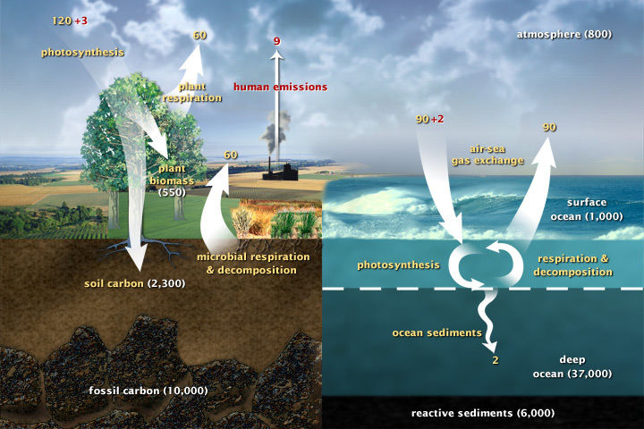
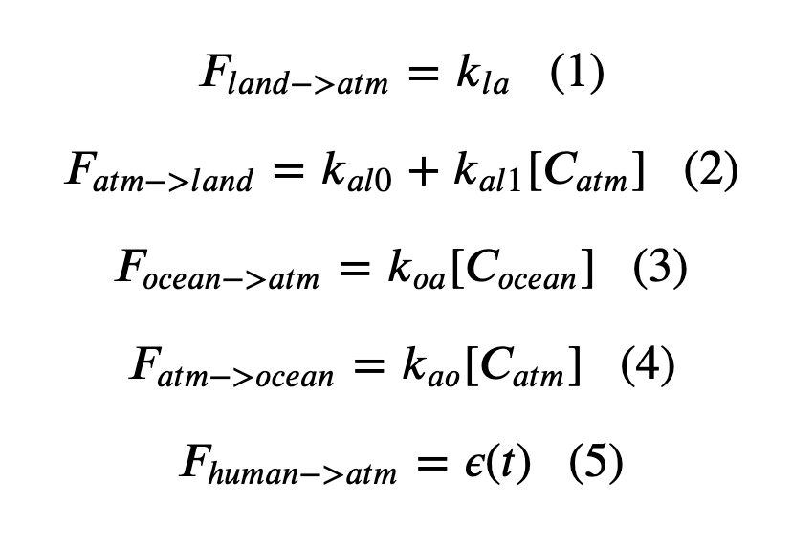
Cambio1.0
Euler’s method:
In a loop, we calculated fluxes

Slide 2
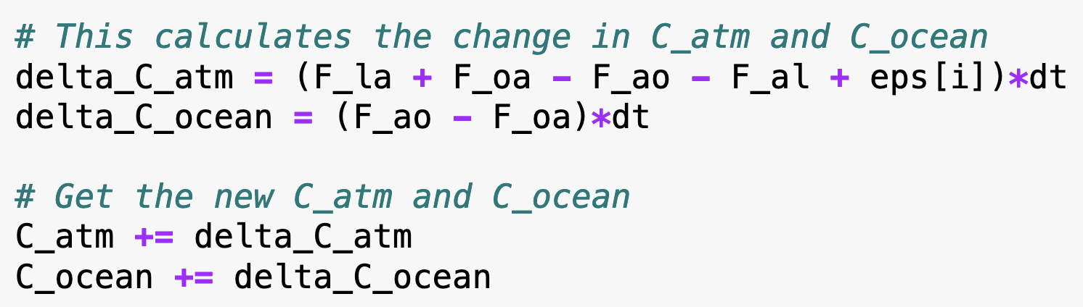
Cambio1.0
Euler’s method:
Then we calculated changes to the concentrations in the atmosphere and oceans

Slide 3
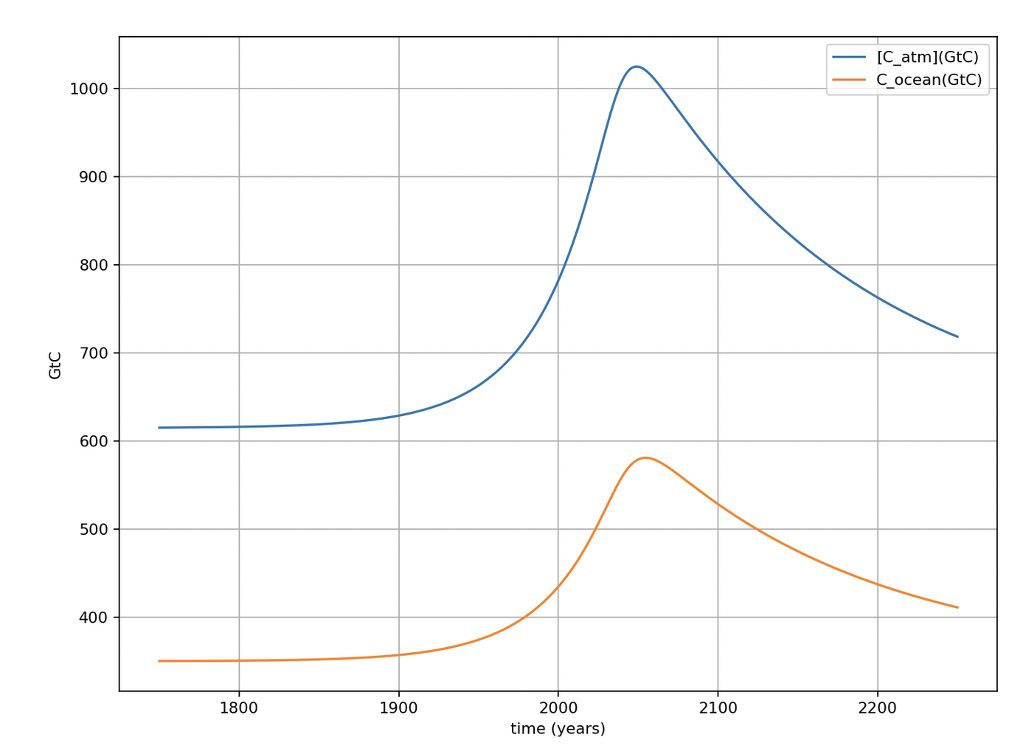
Amounts in the atmosphere and the upper ocean
615 GtC in air (pre-industrial)
Pre-industrial carbon amounts
350 GtC in upper ocean (pre-industrial)

Slide 4
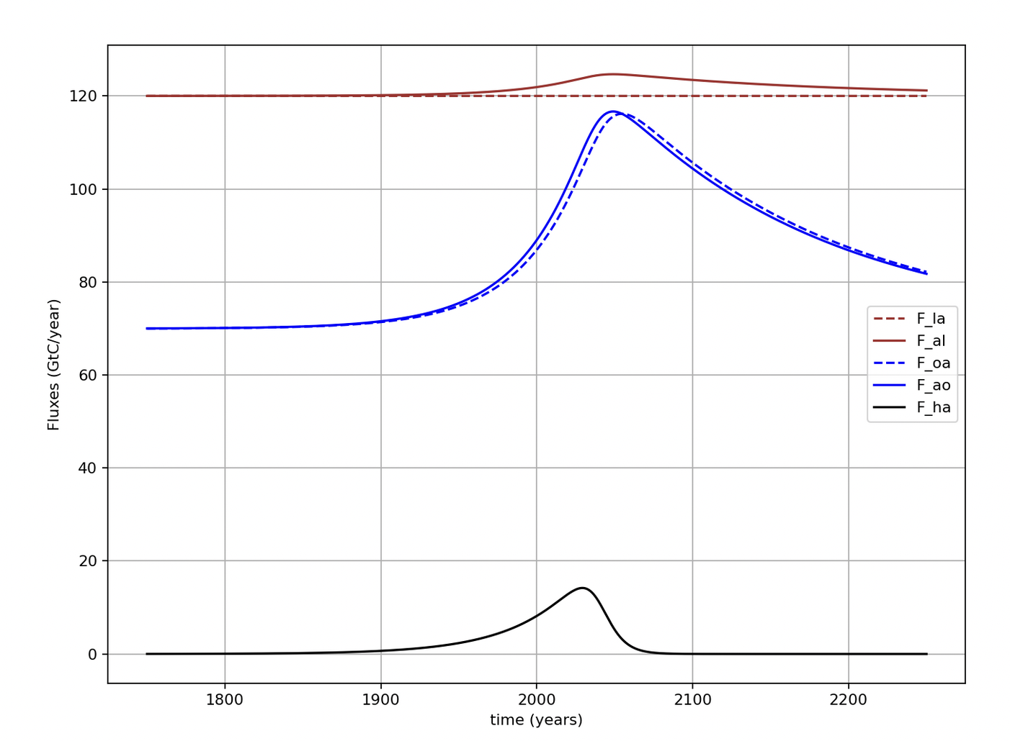
Clear that we’re modeling small differences between big numbers (fluxes)

Slide 5
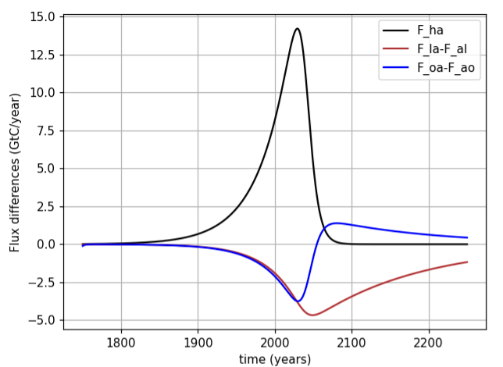
Right now (year 2023) it looks like net fluxes to land and oceans are about ¼ of anthropogenic flux to atmosphere
We can say that the sum of these sinks (about ½ of anthropogenic flux) is Earth’s ”free” ecosystem service

Slide 6
But oceans are more like a lending library
Oceans become a net source of carbon around mid-century
Peak net ocean-to-atmosphere flux

Slide 7
New ideas for today
New ideas for today:
Distinguishing between parametric, prognostic, and diagnostic variables
Storing parametric variables in a Python Dictionary (ClimateParams)
Functionalizing the computation of diagnostic variables

Slide 8
Distinguishing between parametric, prognostic, and diagnostic variables
Parametric variables
Constants, specified prior to the Euler loop.
Found on the right-hand-side of assignments in the loop.
Diagnostic variables
Appear on the left-hand-side of assignments in the loop (i.e., they’re calculated, even graphed), but not essential to the loop.
Examples: temperature anomaly, ocean pH.
Prognostic variables
Appear on the left-hand-side and the right-hand-side of assignments in the Euler loop (i.e., they are essential to the loop).
Examples: C_atm, C_ocean, F_oa, etc.

Slide 9
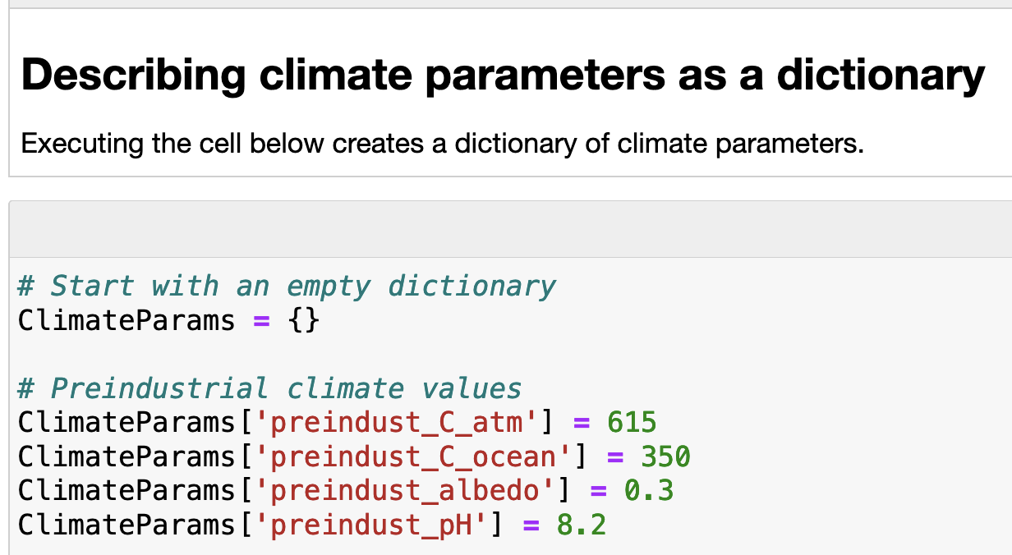
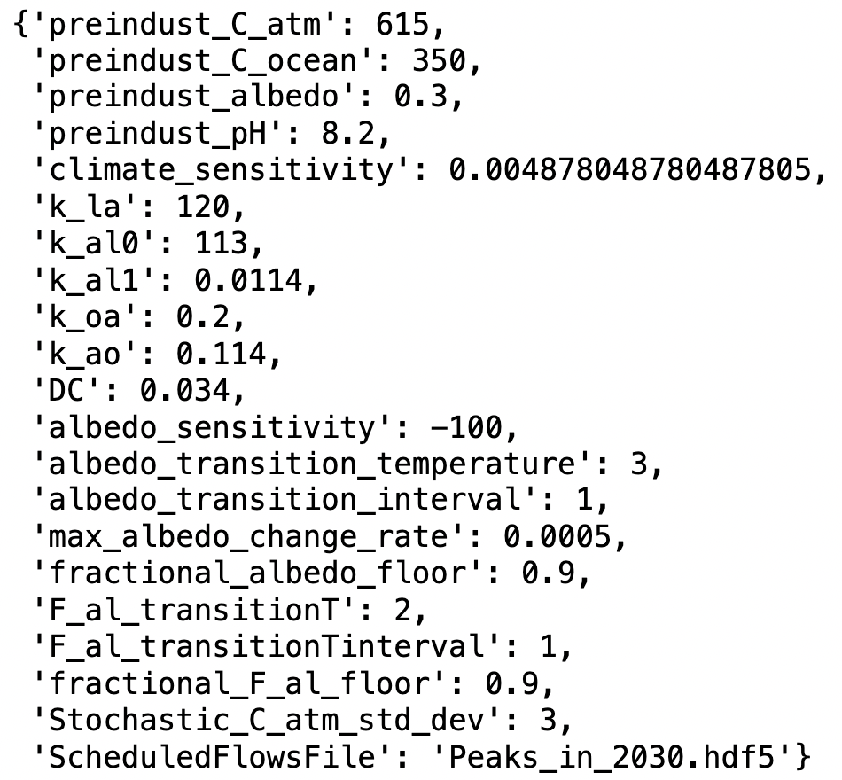
Parametric variables: We have so many, we’re going to store them in a Python Dictionary

Slide 10
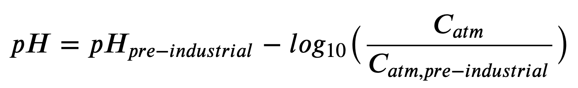
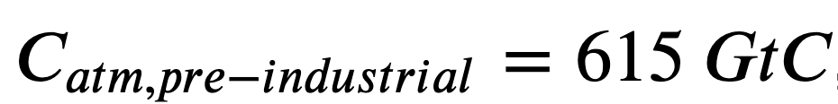











Diagnostic variables: Ocean pH (acidity)
Air
$$CO_{2}$$
$$H_{2}O$$
$$H_{2}O$$
Oceans
$H_{2}CO_{3}$
$$H^{+}$$
$$H^{+}$$
$$HCO_{3}^{−}$$
$${Ca}^{2+}$$
$$CO_{3}^{2−}$$
Sea floor
$$CaCO_{3}$$
$$CaCO_{3}^{}$$

Slide 11
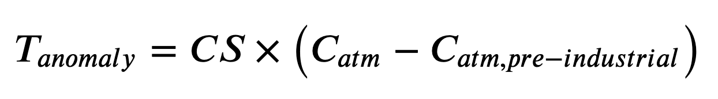
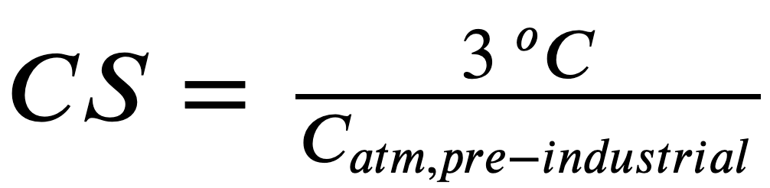
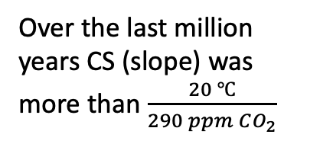

Diagnostic variables: The temperature anomaly
Over the last million years CS (slope) was more than $\frac{20 ℃}{290 ppm CO_{2}}$
T (relative to 1960)
Over the last 150 years, CS has been about $\frac{2.7 ℃}{290 ppm CO_{2}}$
Courtesy Penny Rowe
Courtesy Penny Rowe

Slide 12
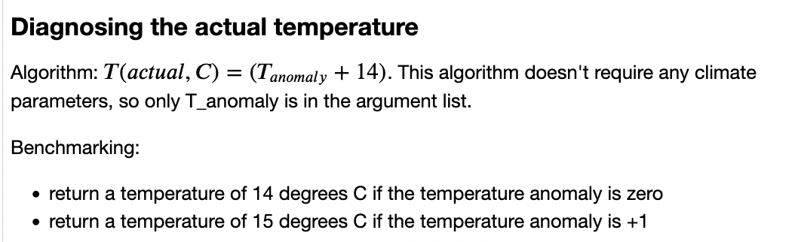
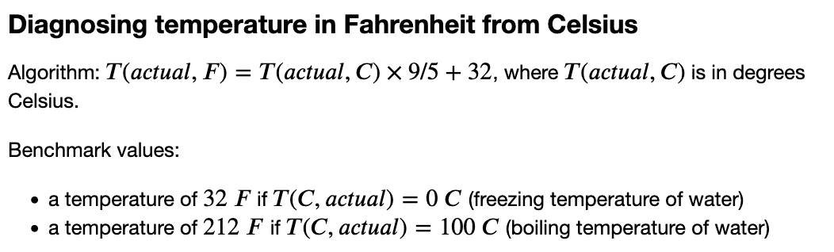
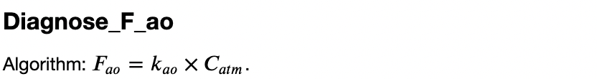
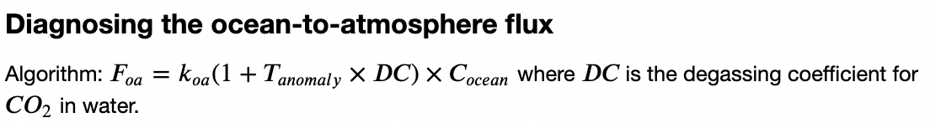
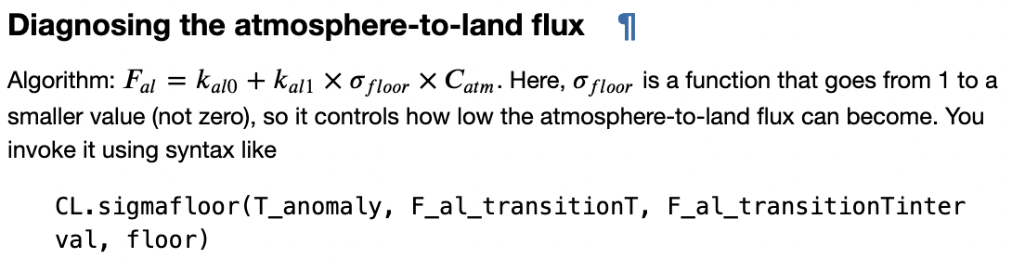
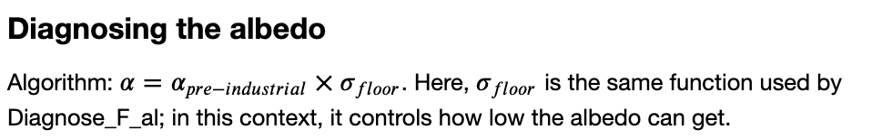
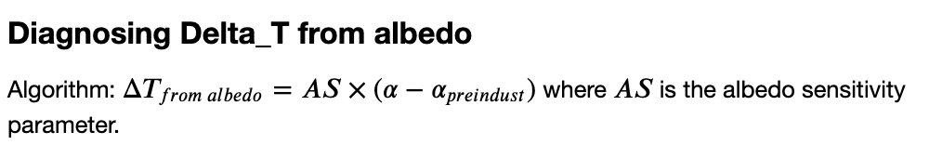
Functionalizing the calculation of diagnostic variables

